Slide 1

Intuitive DESIGN

Slide 2


First UX Designer

Slide 3
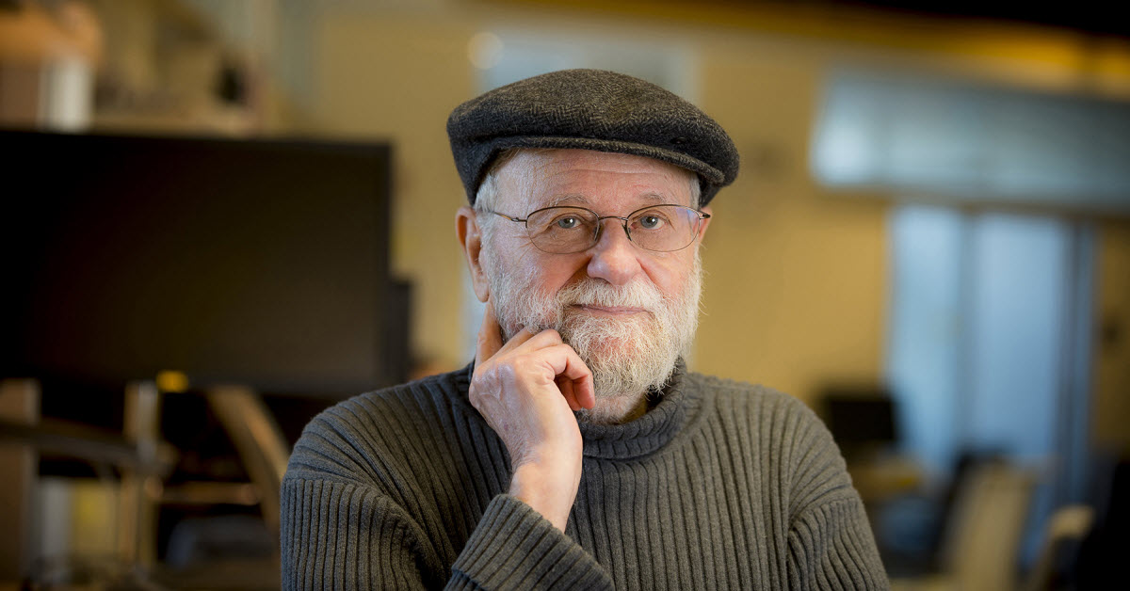
The trouble with UNIX: The user interface is horrid

Slide 4
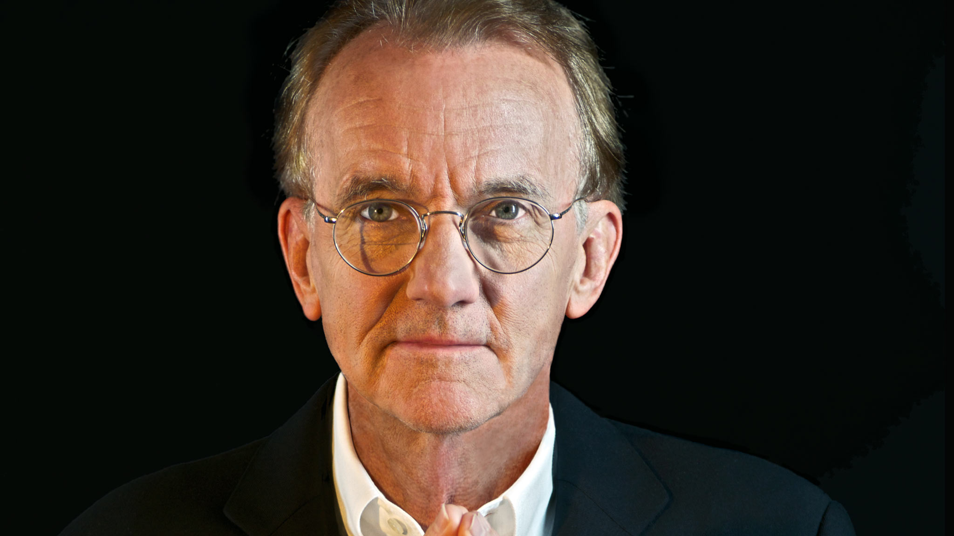
EDWARD Tufte

Slide 6

What is Intuitive
Familiar

Slide 7
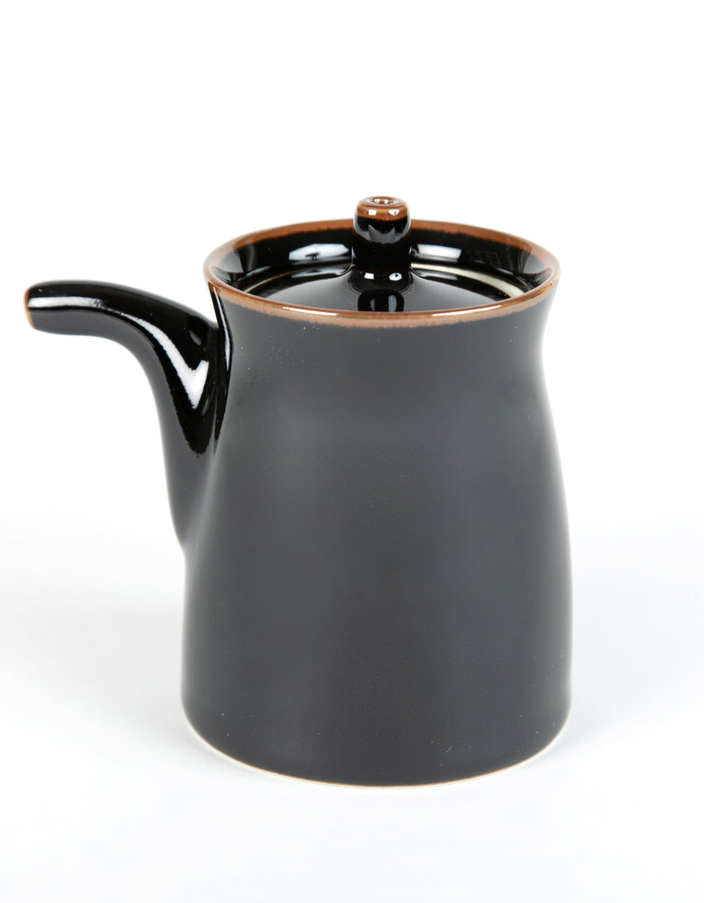
Masahiro Mori

Slide 8
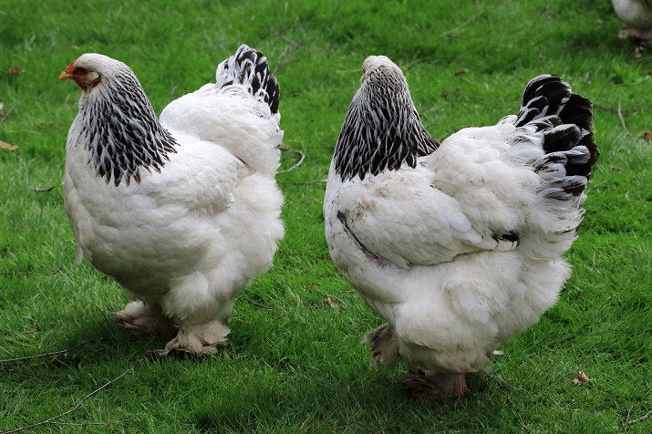
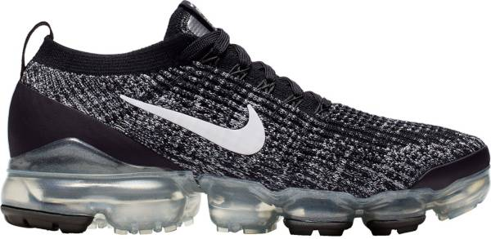
Opinion, Size, Age, Shape, Color, Origin, Material, Purpose

Slide 9
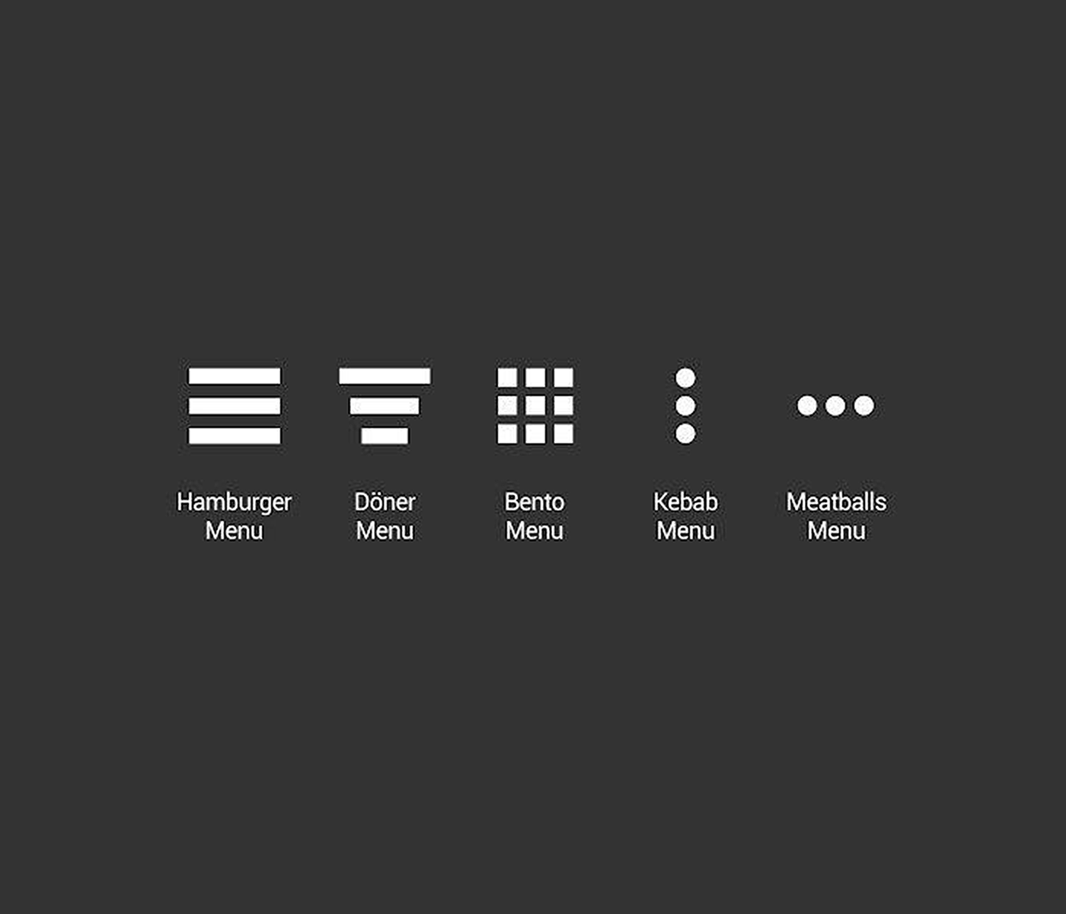
Hamburger Menu

Slide 10
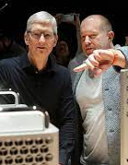
Design at Apple

Slide 11
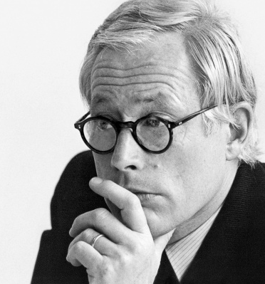
DIETER RAMS
Good design is innovative
Good design makes a product useful
Good design is aesthetic
Good design makes a product understandable
Good design is unobtrusive
Good design is honest
Good design is long-lasting
Good design is thorough down to the last detail
Good design is environmentally-friendly
Good design is as little design as possible

Slide 12
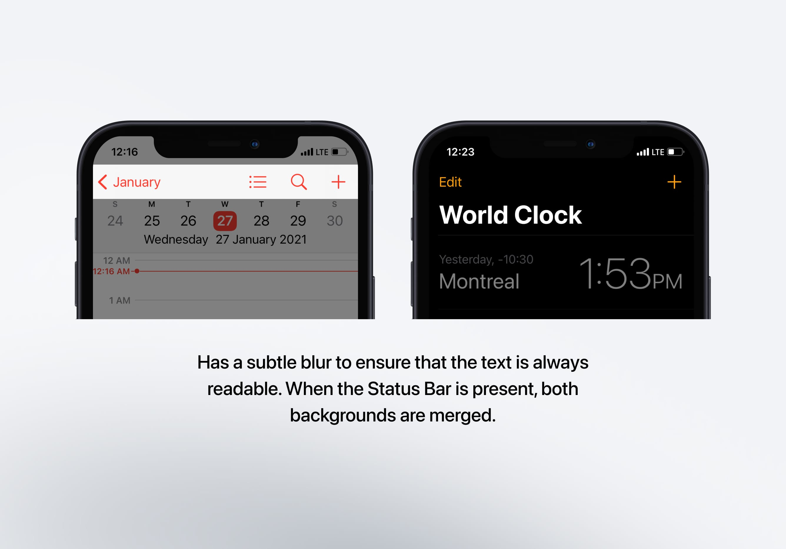
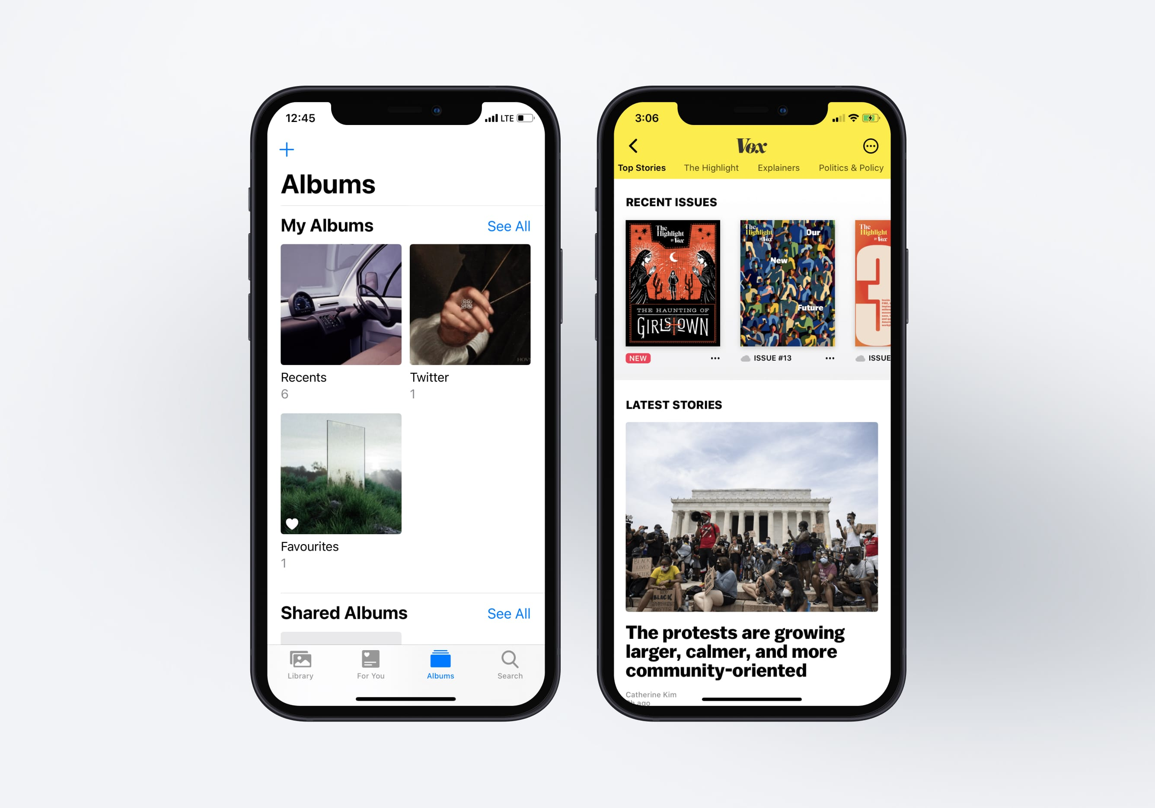
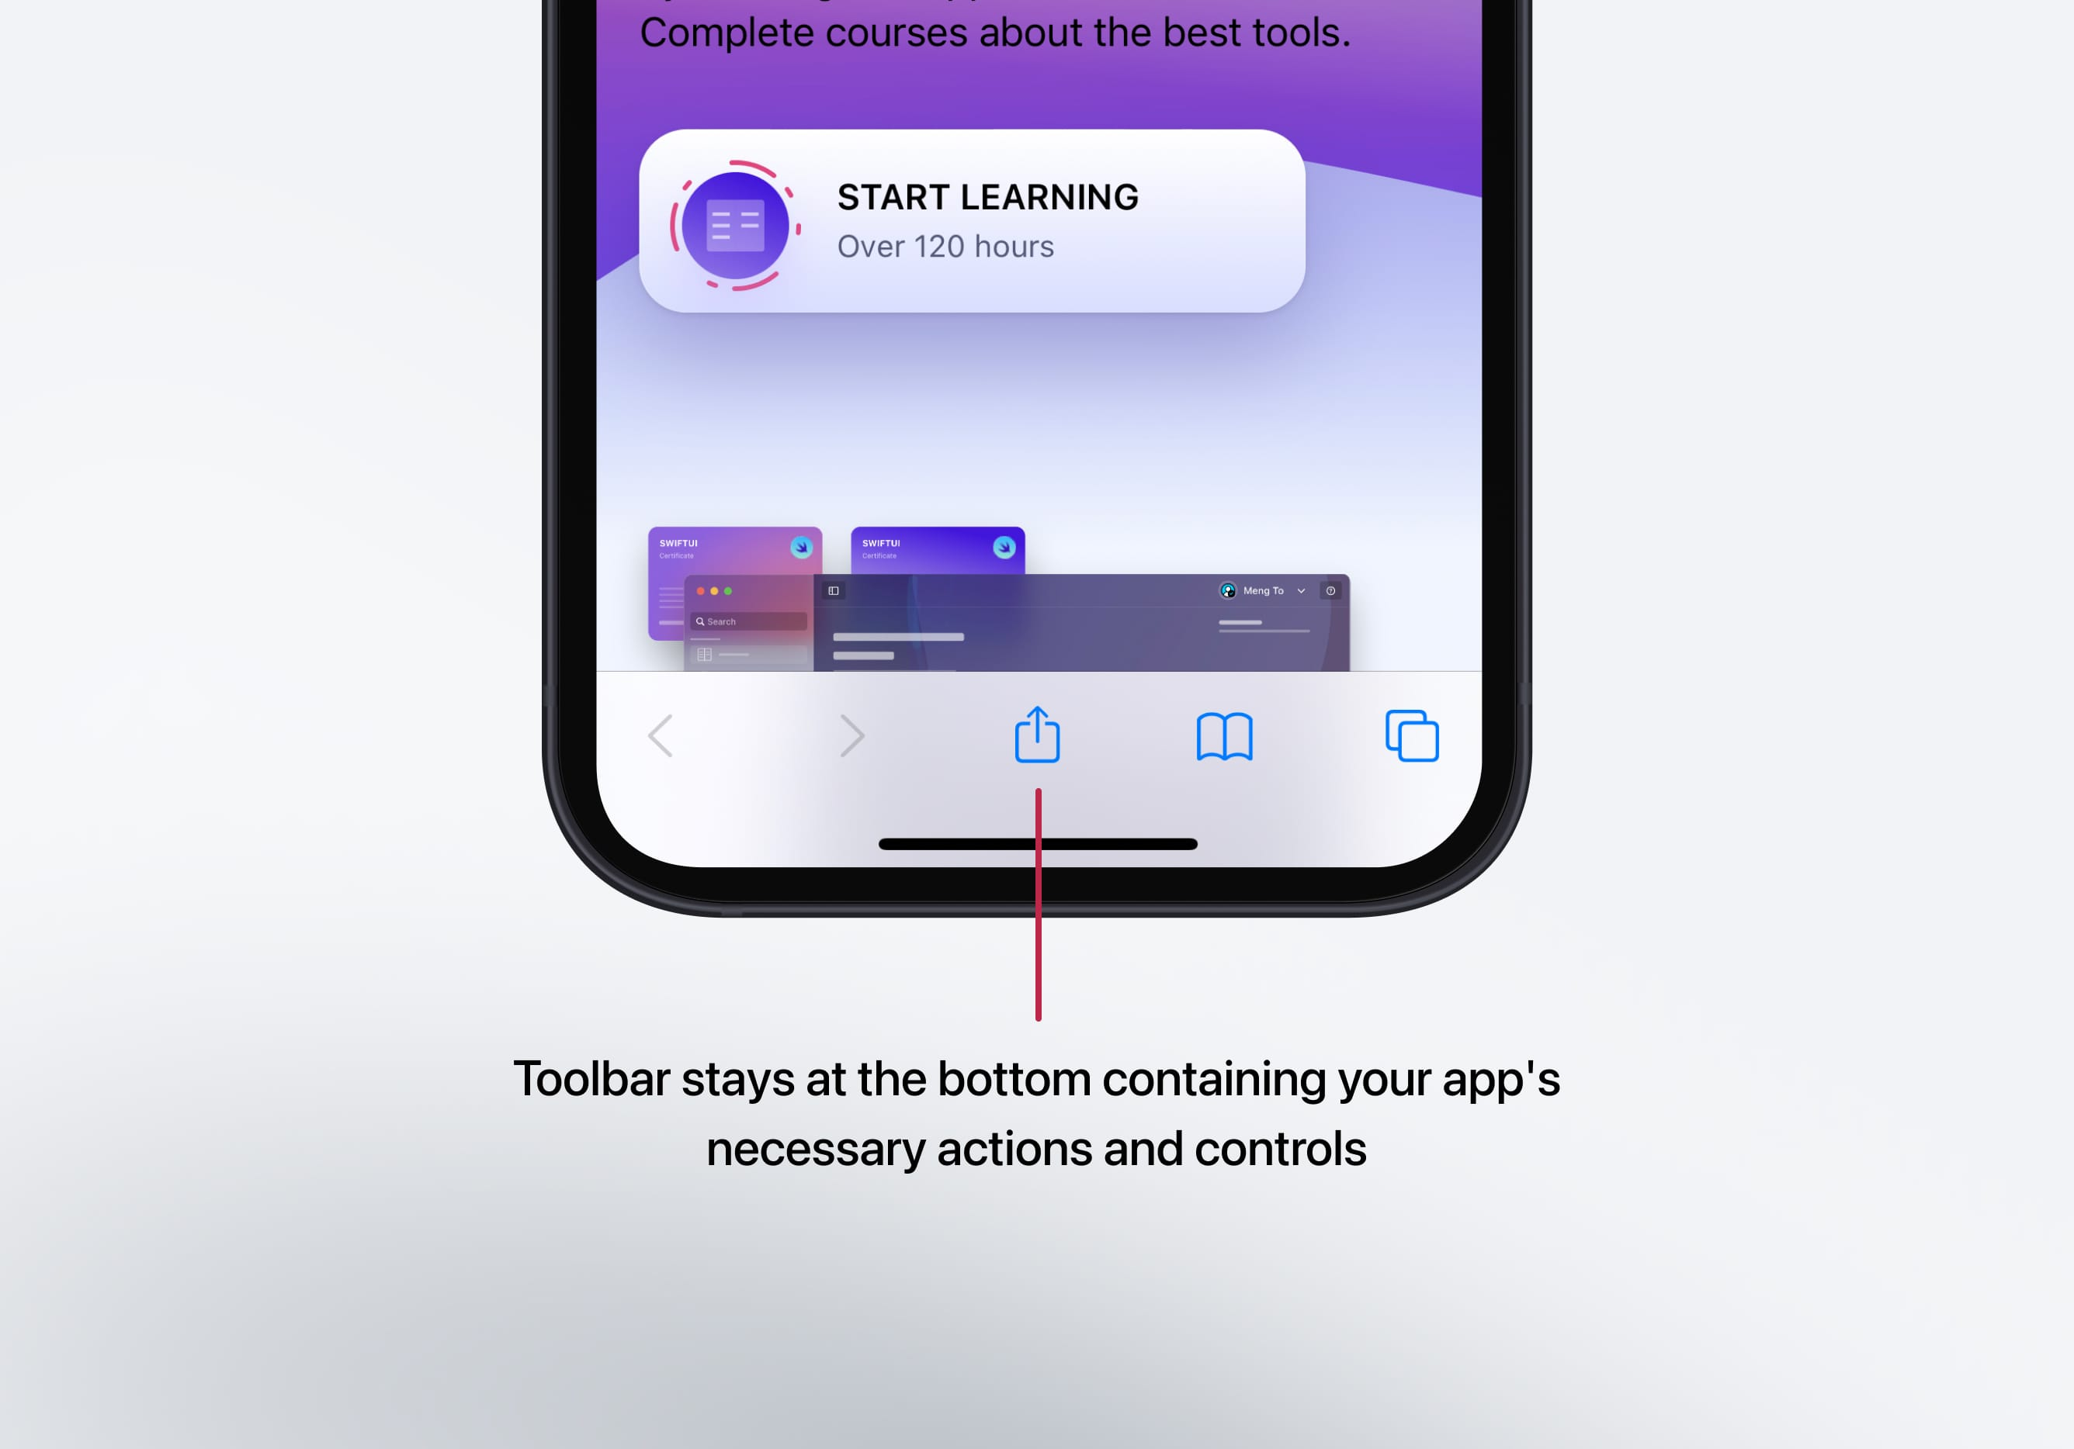
Common Apple elements

Slide 13
Applied Principles
Transference
Habituation

Slide 14
Is it Intuitive?

